Slide 1

Crime Data Analysis Power BI
Vaibhav Prakash Gupta
11 FEB 2024

Slide 2

INTRODUCTION
Objectives with Problem Statement
Crime analysis data snapshot
Analytics Approach and tools
Analytics Approach and tools
Insights and Recommendations
DASHBOARD
CONCLUSION

Slide 3

Introduction
Crime data analysis is a crucial tool in understanding and combating criminal activities within communities. By examining data collected from law enforcement agencies, researchers, and other sources, analysts can uncover patterns, trends, and insights that inform decision-making, policy development, and resource allocation.

Slide 4
Objectives with Problem Statement
Analyze historical crime data to identify patterns, trends, and emerging issues in criminal activities.
The problem statement for crime data analysis revolves around understanding and addressing criminal activities within a community. Key aspects of the problem statement.

Slide 5
Crime analysis data snapshot
There are 91 Thousands of crimes happened in the country according to data. And the total number of arrest is only 11 Thousands. 18 Thousands of crimes comes under the Domestic Crimes. Average days to solve a case was 9.10.
And the maximum number of crimes happens in Theft that is 20.3K and minimum number of crimes happened in Human Trafficking is 10, Gambling is 4, non-Criminal is 2, Other Narcotic Violation and Public Indecency is 1.
The crime data provided for analysis includes information on reported incidents, including details such as the type of crime, location, date and time of occurrence, and any arrests made.

Slide 6
Key DATA ELEMENTS
Crime Type: Classification of criminal activities, including but not limited to theft, assault, burglary, vandalism, and drug offenses.
Location: Geographic coordinates or address details indicating where the crime occurred, including information on specific neighborhoods, streets, or landmarks.
Date and Time: Timestamps indicating the date and time when the crime was reported or occurred, enabling temporal analysis and trend identification.
Arrest Information: Details on any arrests made in connection with reported incidents, including the number of arrests and the demographics of individuals apprehended.

Slide 7
Analytics Approach and tools
Data Cleaning: Utilized functions like Split Column, Trim, and Remove Duplicate to ensure data accuracy.
Assessing the frequency of crime :
Total Case = COUNT (crimes_data_2022[Type]).
Calculating the Arrest Rate:
( Numbers of Arrests / Number of Reported Incidents)
* 100.
Formula for calculating the Domestic Crime:
=CALCULATE(COUNTROWS('crimes_data_2022’),
'crimes_data_2022’ [Domestic]=TRUE
Formula used for this column is:
Solve Case in Day
=DATEDIFF('crimes_data_2022'[Date],
crimes_data_2022[Updated Date], DAY)

Slide 8
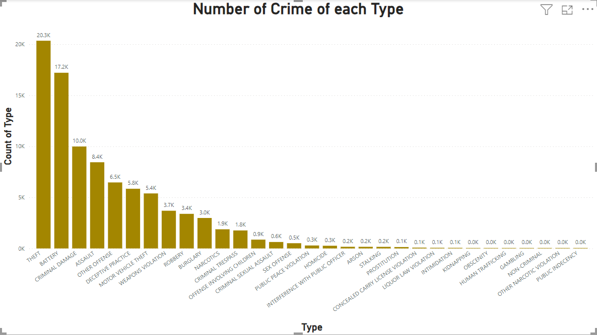
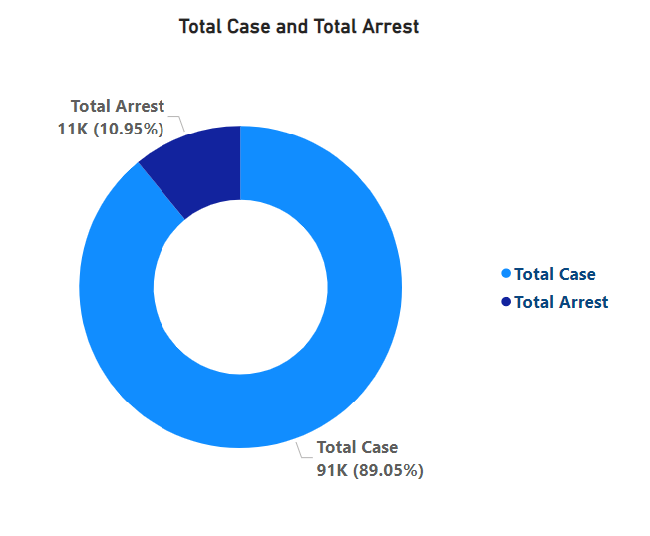
Crime Analysis
The maximum number of crimes happens in Theft that is 20.3K and minimum number of crimes happened in Human Trafficking is 10, Gambling is 4, non-Criminal is 2, Other Narcotic Violation and Public Indecency is 1.
As per our analysis we find that the maximum number of arrests was in Battery Type of crime and Weapon Violation crime that was 2394 and 2339 and the minimum number of arrests in Narcotic Violation and Public Indecency that was 1 and 1 arrest in both.

Slide 9
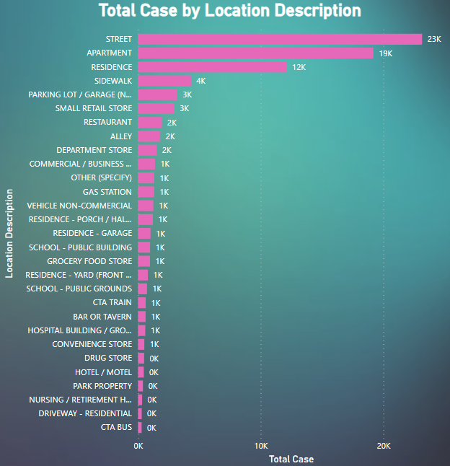
Crime Hotspots & Key Finding
Maximum number of crimes happened in Street that was 23151 crimes and on second position Apartments 19177 crimes registered as per location.
And the minimum number of crimes registered at Airports, Bar-bar Shop, CTA “L” Train, Garage, Liquor Store, Stairwell and Vestibule that is only 1.

Slide 10
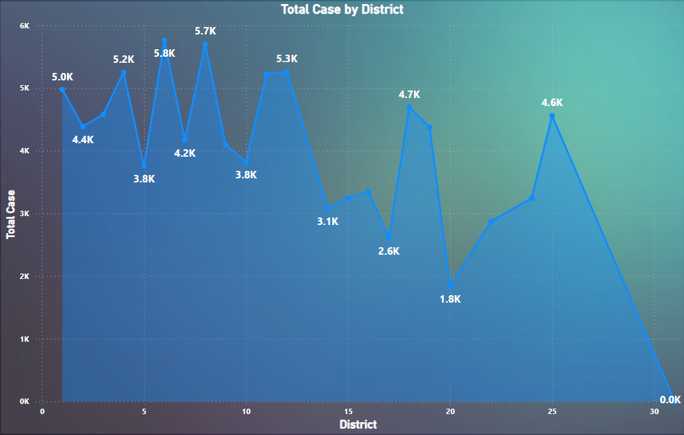
We find the number of Cases in the district. In District 6 we get 5763 and district 8 we get 5701 total cases was registered. These top two districts crime was very high.
We find the number of Cases in the district. In District 6 we get 5763 and district 8 we get 5701 total cases was registered. These top two districts crime was very high.

Slide 11
Crime Prevention Strategies
Data-Driven Approach:
Analyze crime data to identify patterns, trends, and hotspots.
Community Engagement and Empowerment:
Foster collaboration between law enforcement agencies, community organizations, and residents.
Establish neighborhood watch programs and encourage community members to report suspicious activities.
Targeted Policing Strategies: Increased police patrols and law enforcement presence in high-crime areas.
Continuous Monitoring and Evaluation: Installation of surveillance cameras and security lighting to determine criminal activity and enhance visibility.
Preventive Measures: Collaboration with local businesses, schools, religious institutions, and community organizations to promote safety and crime prevention efforts.
Focus on High-Impact Crime Types: Analyse crime data to identify high-impact crime types that have a significant impact on public safety and community well-being.

Slide 12
Crime Hotspots:
Identify areas with the highest concentration of criminal activity.
Determine the types of crimes most prevalent in each hotspot.
Analyze socio-economic factors contributing to hotspot locations.
Crime Trends:
Evaluate trends in different types of crimes over time.
Identify seasonal patterns or spikes in criminal activity.
Examine correlations between crime trends and external factors such as economic conditions or population demographics.
Arrest Rates and Case Closure:
Evaluate arrest rates and case closure rates for different types of crimes.
Identify factors influencing successful apprehension and prosecution of offenders.
Explore opportunities to improve investigative techniques and collaboration between law enforcement agencies.
Insights
&
Recommendations

Slide 13
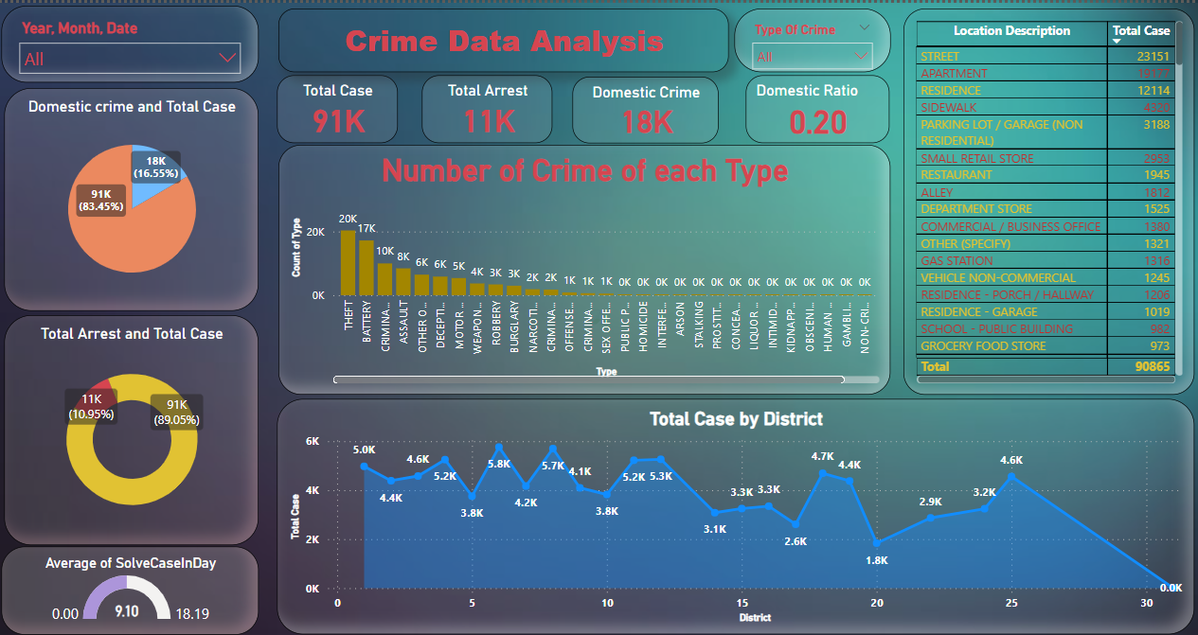
DASHBOARD

Slide 14
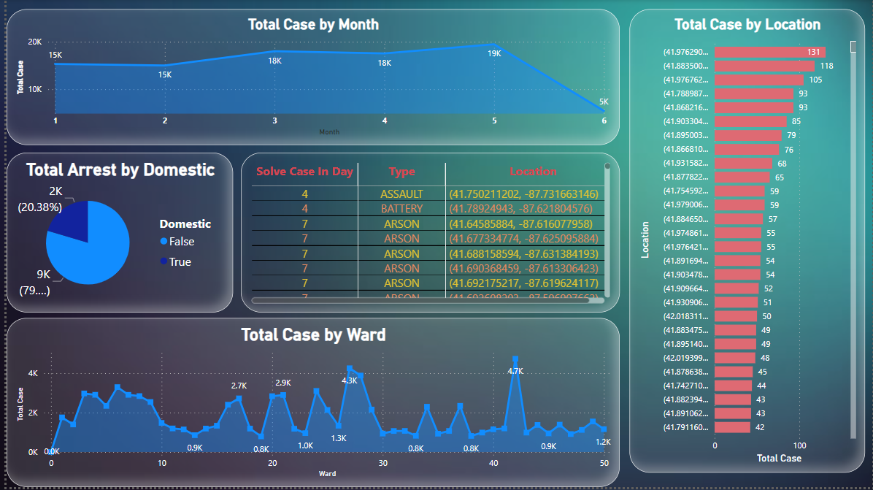
DASHBOARD-2

Slide 15

CONCLUSION
In conclusion, crime analysis plays a crucial role in understanding, addressing, and preventing criminal activities within communities. By leveraging data-driven insights, engaging with stakeholders, and implementing targeted interventions, we can work towards reducing crime rates and creating safer environments for all.
Throughout this analysis, we have identified key patterns, trends, and hotspots, allowing us to prioritize resources and interventions effectively. We have highlighted the importance of community engagement, collaboration, and empowerment in fostering a collective response to crime prevention.
Moving forward, it is essential to continue leveraging data analytics, technology, and innovation to enhance crime prevention efforts. By adopting a holistic approach that combines proactive policing, community involvement, and social interventions, we can create safer, more resilient communities for generations to come.

Slide 16


